Slide 1
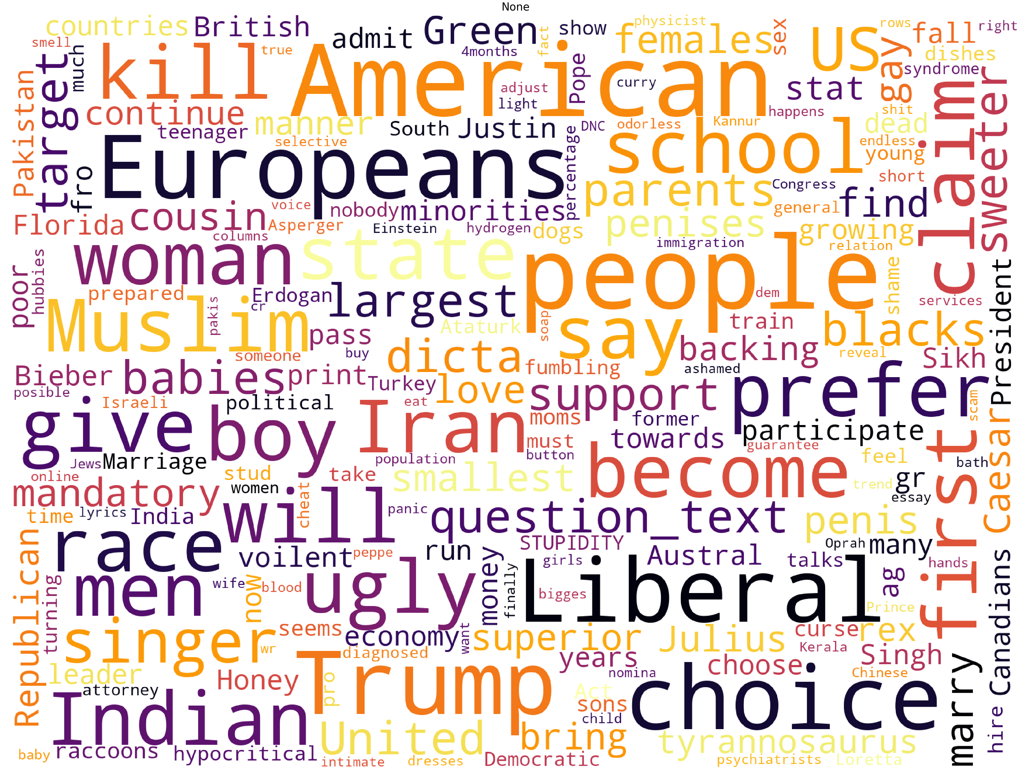
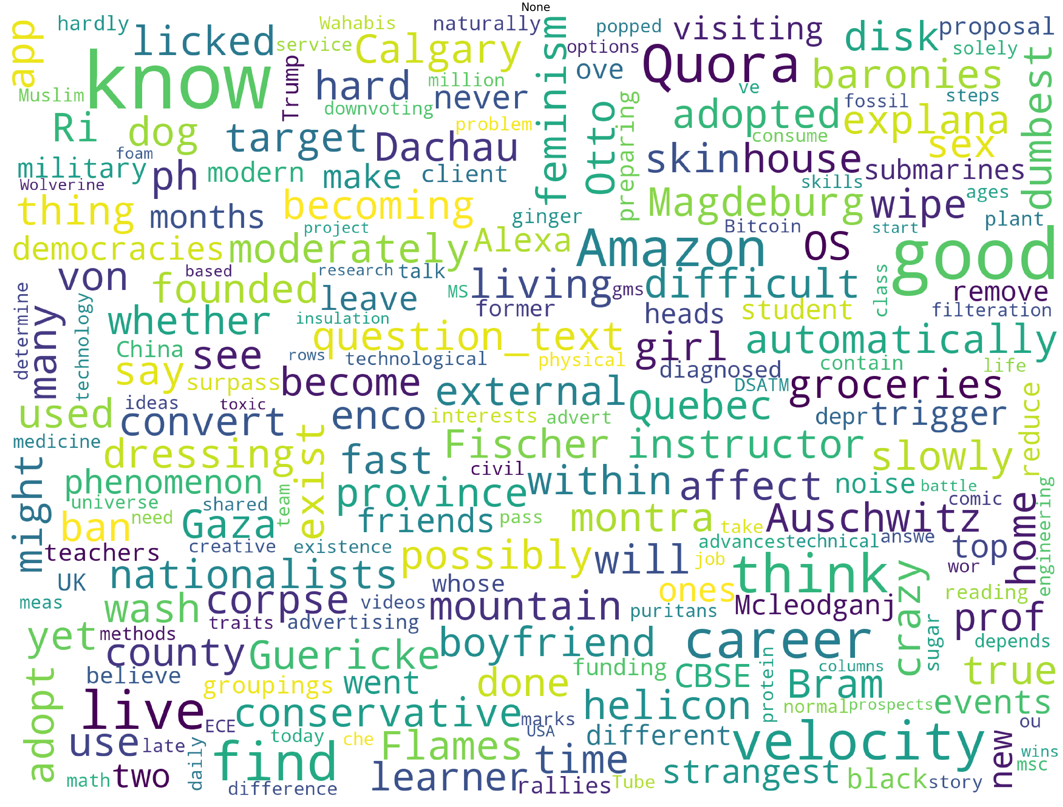

Kaggle: Classifying Quora Question Sincerity
Clive Unger, Avishka Suduwa Dewage, Andy Chang, Nicholas Edelman, Nicolas Key
EE 461P Data Science Principles Final Project
Introduction:
Exploratory Data Analysis:
Embeddings:
Quora.com is a platform where people can ask questions and connect with others who contribute unique insights and quality answers.
A key challenge is to weed out insincere questions, founded upon false premises, or intending to make a statement rather than look for helpful answers.
In this competition, Kagglers will develop models that identify and flag insincere questions.
Why use embeddings?
All rows of data have same # of features
Superior performance to bag of words
Embeddings as features have meaning
Which embeddings?
Provided pretrained embeddings had better performance than self trained embeddings
Modeling:
Data:
GRU based RNN w/ 1 GRU:
Currently 50%, 0.67 public score on Kaggle
Embedding layer
Bidirectional GRU layer
Ensembling results based on all pretrained embeddings gave best performance
Logistic Regression:
Used as part of data exploration
Trained on TF-IDF vectorized data
Examining feature importance through weights
Question strings labeled as sincere or insincere.
Some characteristics that make questions insincere:
Has a non-neutral tone
Is disparaging or inflammatory
Isn't grounded in reality
Uses sexual content for shock value
Several sets of word embeddings are also provided:
Google word2vec embeddings from Google News
“GloVe” word embeddings from Wikipedia
PPDB Paragram word Embeddings
fastText trained word embeddings from Wikinews
What we Learned:
Evaluation:
Importance of Data Preprocessing for text based data
What are word embeddings and how to use them
Submissions are scored on F1 Score
f$1=2∗\frac{precision ∗recall}{precision+recall}$
Word Cloud - Insincere Questions
Word Cloud - Sincere Questions
Future Steps:
Data Preprocessing:
Experiment more with different embeddings and embedding layer hyperparameters
likely do gridsearch and perform ensembling
Experiment with different RNN configurations, different recurrent blocks
(GRU, LSTM)
Try sentiment analysis
Experiment with padding vectorized sentences and feeding into CNN
Try different NLP techniques
Data Cleaning
Punctuation, word case, grammar
British vs American spellings
Misspellings
Contractions
“Facebook” vs “Instagram” -> “Social medium”
“to”, “and”, meaningless words
Non printable characters
Tokenization requires data cleaning
Data tokenizatability increased from 22% to 97%

